Slide 1
History of Peer Support and Social Context
Module 3
Notes:
Trainer Manual
Module 03: History of Peer Support © 2023 PeerWorks
This training program is designed to be accessible to all trainers, and ensure that all participants receive the same quality of education regardless of specific trainers’ background and experience.
This manual is a living document and should be understood as a set of guidelines, not as a fixed script. Feel free to adapt the language to your style of presentation. We also recognize that language is always changing; please update terminology when necessary. The synchronous sessions should be dynamic, engaging experiences.
TRAINER
Welcomes everyone and states the topic of today’s module.

Slide 2
Land Acknowledgement
Module 3 – History of Peer Support
I am speaking to you today from Toronto. Toronto is in the 'Dish With One Spoon Territory’. The Dish With One Spoon is a treaty between the Anishinaabe, Mississaugas and Haudenosaunee that bound them to share the territory and protect the land. Subsequent Indigenous Nations and peoples, Europeans and all newcomers have been invited into this treaty in the spirit of peace, friendship and respect.
The "Dish", or sometimes it is called the "Bowl", represents what is now southern Ontario, from the Great Lakes to Quebec and from Lake Simcoe into the United States. *We all eat out of the Dish, all of us that share this territory, with only one spoon. That means we have to share the responsibility of ensuring the dish is never empty, which includes taking care of the land and the creatures we share it with. Importantly, no knives are at the table, representing that we must keep the peace.
We want to acknowledge and respect all Indigenous people who don’t live in their traditional territories but have made a home in different parts of Ontario and have brought their culture with them.
Notes:
COORDINATOR
Read out PeerWorks’ land acknowledgement.

Slide 3

Housekeeping
Module 3 – History of Peer Support
Please mute yourself if you are not speaking.
Feel free to include your pronouns in your Zoom Name.
Use Zoom reaction tools, chat box, hands up, etc.
Be prepared to have video on at all times; as such, please be appropriately dressed and limit distractions.
Contribute to the conversations out loud and in the chat box.
If someone has already shared what you were going to say, lower your hand and put “agree” in the chat.
Notes:
COORDINATOR
Read out Housekeeping slide.

Slide 4
Expectations
Module 3 – History of Peer Support
Arrive on time.
Help us create a confidential, non-judgmental space (no screenshots or recordings).
Please keep your phones on silent.
Avoid cross-talk and side-talk.
Learn from each person’s perspective.
Language – please bring new language to us as we recognize that language is ever-changing.
Have fun!
From the group:
[ADD PARTICIPANT ADDITIONS, IF ANY]
Notes:
COORDINATOR
Read out Expectations slide.

Slide 5
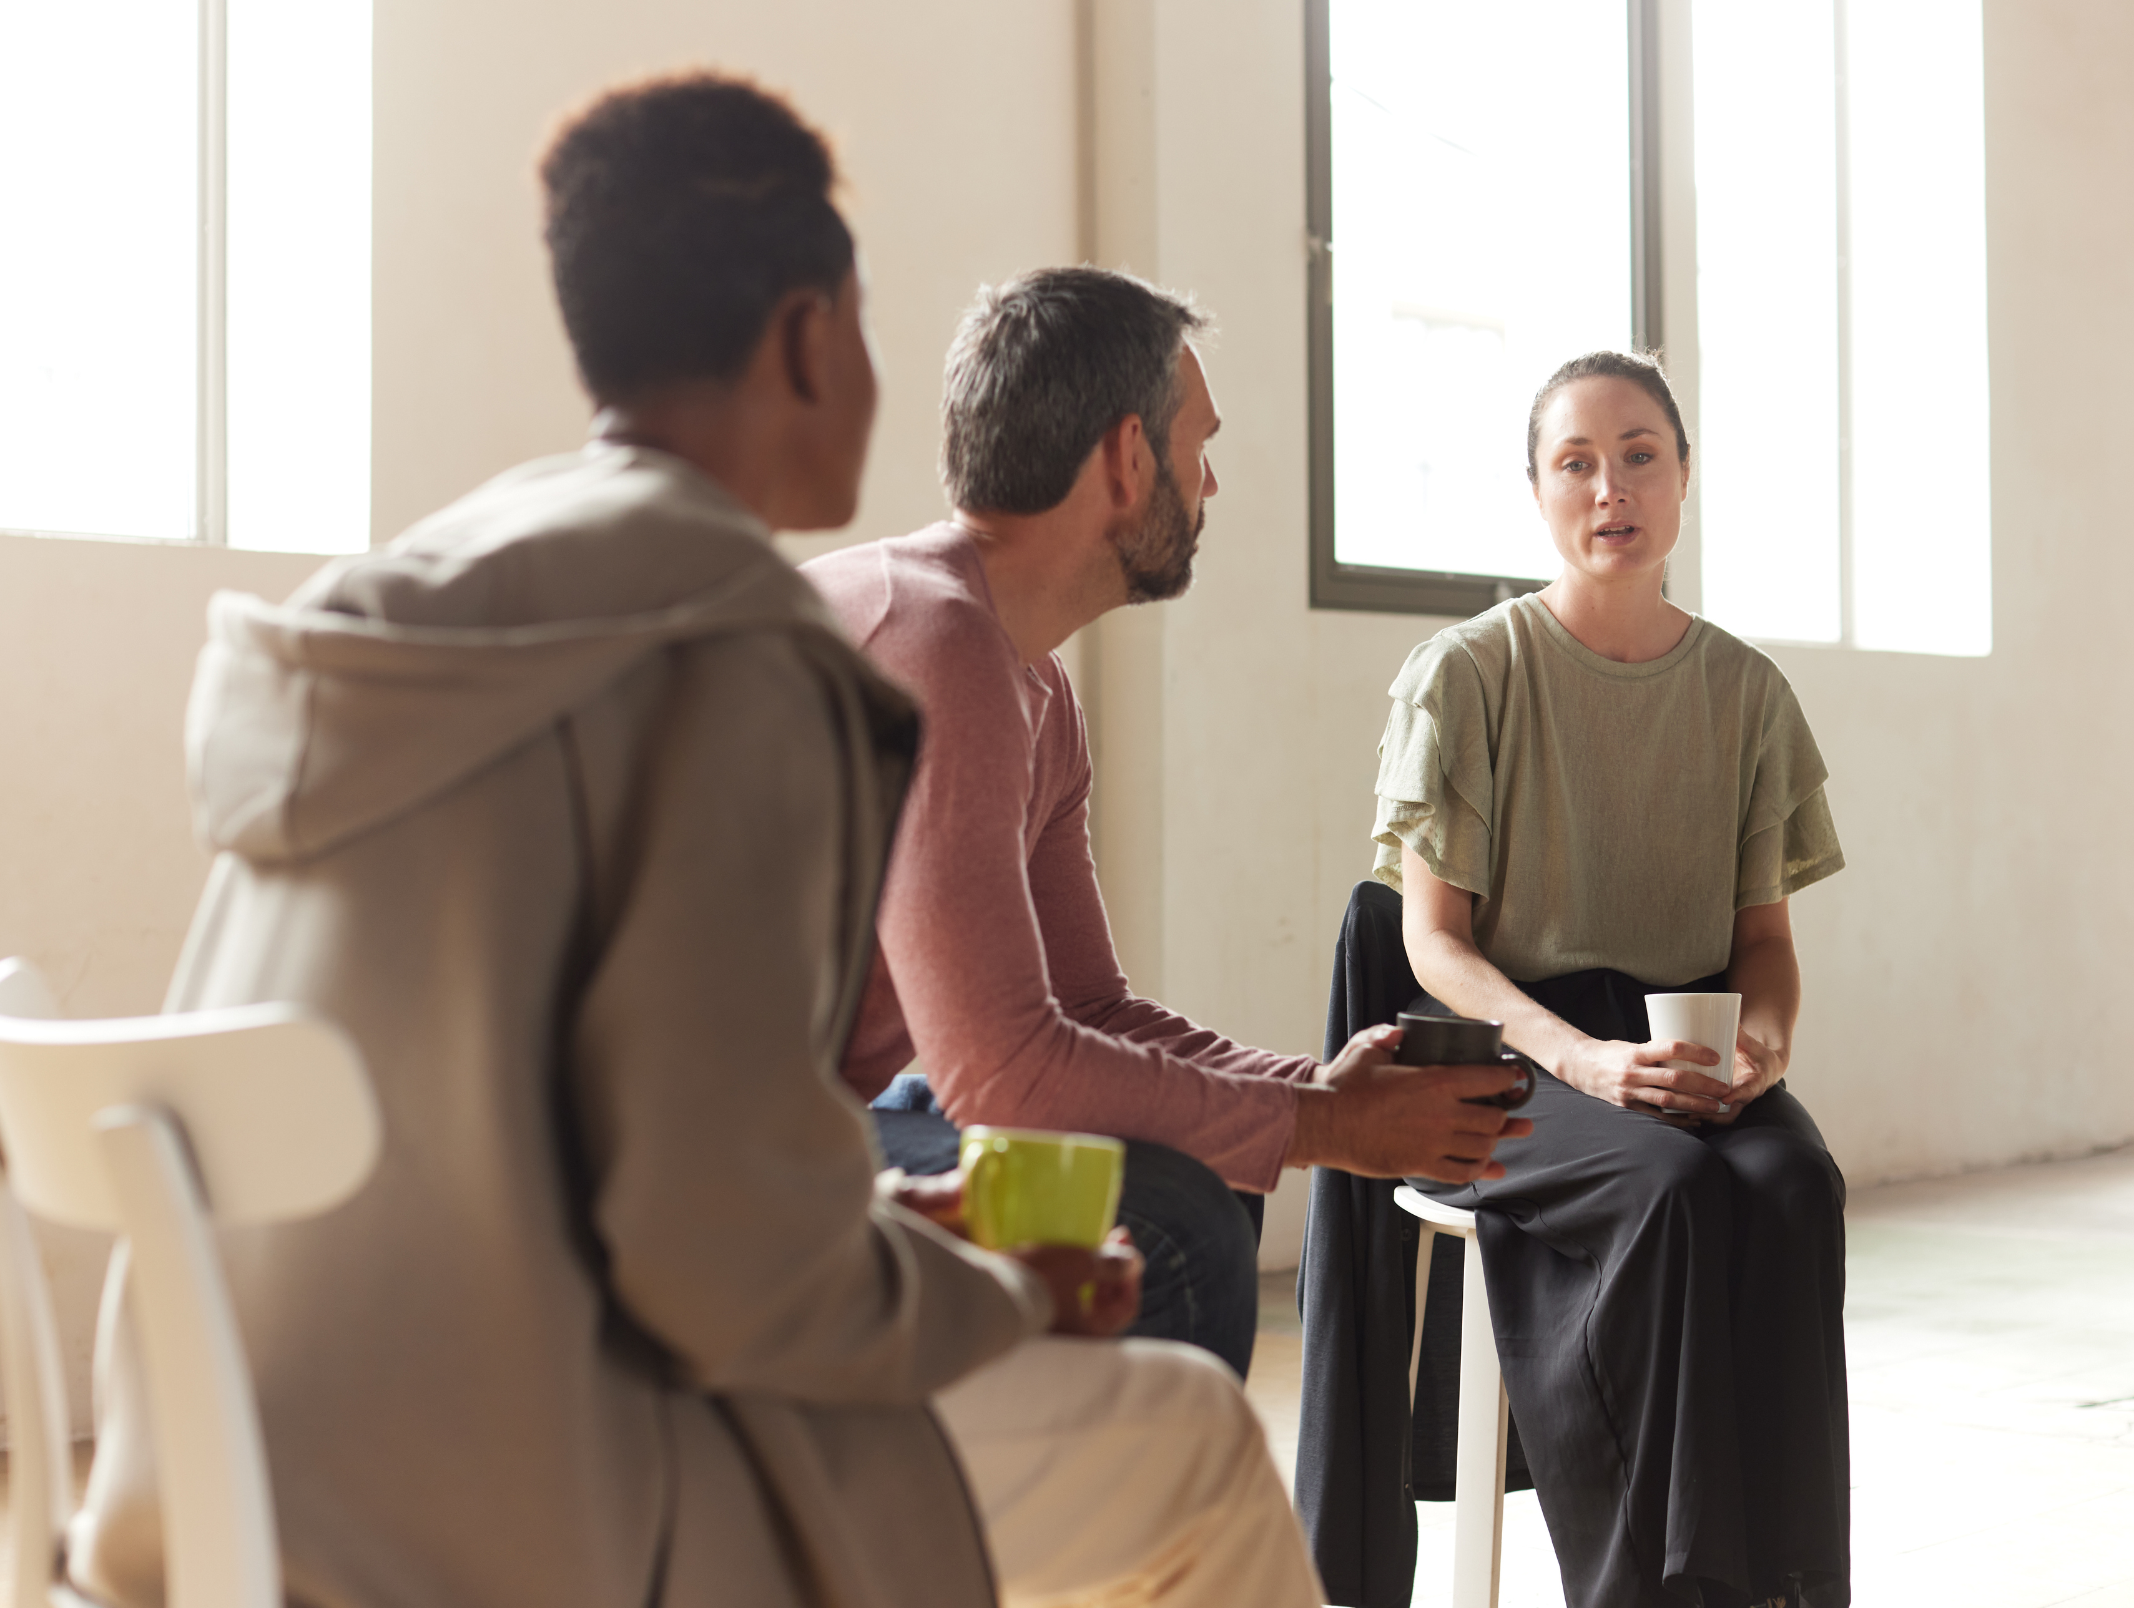
Icebreaker Activity
Module 3 – History of Peer Support
What is your name?
What is the hardest part of participating virtually?
What is the easiest?
Notes:
TRAINER
“What is the hardest part of participating virtually? What is the easiest?”
As the trainers, feel free to go first. Keep it brief and thank people for sharing.
If anyone makes suggestions for ways that the synchronous sessions could be made more accessible, please forward them to our Education Coordinator and, if possible, implement them in future sessions.

Slide 6
Module Overview
Module 3 – History of Peer Support
In Module 3 we will discuss and learn about Peer Supports history and the social context of Peer Support.
We will discover the origins of Peer Support and understand the significance of knowing and acknowledging our history.
We will also learn about social determinants of health and different types of stigma that people with lived experience may encounter.
Notes:
TRAINER
Read the Module Overview and Learning Objectives out loud or invite a participant to read it out loud.

Slide 7
Learning Objectives
Module 3 – History of Peer Support
Through the successful completion of Module 3, you will be able to:
Understand the history of Peer Support and acknowledge its influence on the present day.
Define social determinants of health, both generally and specifically.
Identify the different types of stigma and articulate their impact on Peers and Peer Support.
Notes:
TRAINER
Read the Module Overview and Learning Objectives out loud or invite a participant to read it out loud.

Slide 8
Tell – Help – Check
Module 3 – History of Peer Support
Break into pairs. One person will “tell”, and the other will “help.”
First the “teller” explains the significance of the homework and why it’s important to know the origins of Peer Support (in their own words).
Then, the “helper” will have a turn to bring up anything important that the “teller” did not mention.
This first part of the activity will take 5-10 minutes.
Notes:
COORDINATOR
The first slide introduces the in-class paired activity. The content of the activity is the homework for this module: Al Strong’s History of Peer Support.”
Read out the instructions. Then turn to the next slide to read the second part of the group activity. The first part of the activity will take 5-10 minutes. Feel free to check in on the pairs.
After everyone has come back together and shared their responses, ask if there are any remaining regarding the homework.

Slide 9
Tell – Help – Check
Module 3 – History of Peer Support
Come back to the main group to check in and see what the other pairs produced.
One pair volunteers to go first. Then, the rest of the pairs follow, adding anything they came up with that hasn’t yet been mentioned.
Notes:
COORDINATOR
The first slide introduces the in-class paired activity. The content of the activity is the homework for this module: Al Strong’s History of Peer Support.”
Read out the instructions. Then turn to the next slide to read the second part of the group activity. The first part of the activity will take 5-10 minutes. Feel free to check in on the pairs.
After everyone has come back together and shared their responses, ask if there are any remaining regarding the homework.

Slide 10
DETERMINANTS OF HEALTH: are the broad range of personal, social, economic and environmental factors that determine individual and population health.
The main determinants of health include:
Income and social status
Employment and working conditions
Education and literacy
Childhood experiences
Physical environments
Social supports and coping skills
Healthy behaviours
Access to health services
Biology and genetic endowment
Gender/sexism
Culture
Race/racism
Notes:
TRAINER
The main informative pieces of this synchronous session will be on the determinants of health. Read out this first slide and introduce participants to this concept.

Slide 11
Social Determinants of Health
Module 3 – History of Peer Support
Refers to a specific group of social and economic factors within the broader determinants of health.
These relate to an individual's place in society, such as income, education or employment.
Experiences of discrimination, racism and historical trauma are important social determinants of health for certain groups such as Indigenous Peoples, LGBTQ2S+ and Black Canadians.
Notes:
TRAINER
“Next we will be discussing the social determinants of health. These are a subcategory within the determinants of health. Could someone please read this definition out loud for us?”
Some people might not be familiar with the LGBTQ2S+ acronym. It stands for Lesbian, Gay, Transgender, Queer, 2 Spirit and the + signals the inclusion of other gender identities and sexual identities, such as Asexual and Intersex.

Slide 12
Considering that definition, which of these are social determinants of health?
Module 3 – History of Peer Support
Income and social status
Employment and working conditions
Education and literacy
Childhood experiences
Physical environments
Social supports and coping skills
Healthy behaviours
Access to health services
Biology and genetic endowment
Gender/sexism
Culture
Race/racism
Notes:
TRAINER
Ask the participants to answer the question through group discussion. If the group is quiet, start with number one and work your way through the list as a group.

Slide 13
Which experiences do we share?
Where do we differ?
How have these determinants impacted us?
Module 3 – History of Peer Support
Income and social status
Employment and working conditions
Education and literacy
Childhood experiences
Physical environments
Social supports and coping skills
Healthy behaviours
Access to health services
Biology and genetic endowment
Gender/sexism
Culture
Race/racism
Notes:
TRAINER
Open this up to a group discussion. Give the group time to consider their personal experiences and ask them how these determinants have impacted their lives and their experience with mental health and addictions.

Slide 14
Module 3 – History of Peer Support
Health inequalities are differences in the health status of individuals and groups. These differences can be due to your genes and the choices you make. For example, whether you exercise or drink alcohol. However, the social determinants of health can also have an important influence on health. For example, Canadians with higher incomes are often healthier than those with lower incomes.
Health inequity refers to health inequalities that are unfair or unjust and modifiable. For example, Canadians who live in remote or northern regions do not have the same access to nutritious foods such as fruits and vegetables as other Canadians.
Health equity is the absence of unfair systems and policies that cause health inequalities. Health equity seeks to reduce inequalities and increase access to opportunities and conditions conducive to health for all.
Notes:
TRAINER
“Next we are going to talk about health inequalities, which are impacted by the determinants of health. Could someone read out this slide?
Are there any questions about this terminology and the difference between an inequality and inequity?”

Slide 15
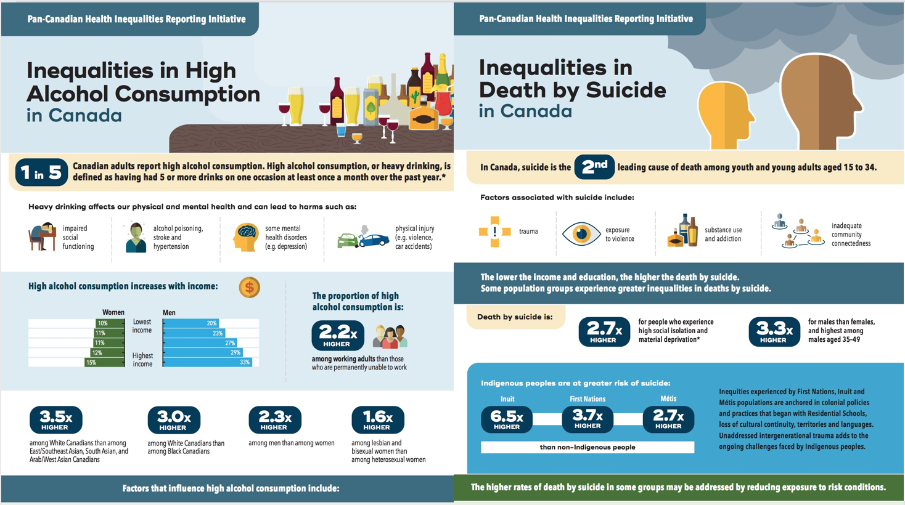
Notes:
TRAINER
These slides are an example of two health inequalities in Canada. If there is time, go through the slide with the group. Let them know that these slides are available in the resources section of their Homework.
At this point, you should be halfway through your time allotment.

Slide 16

Module 3 – History of Peer Support
“Every year, more than one million people in Ontario experience a mental health or addictions challenge requiring care. Often, supports are difficult to find where and when they are needed.”
- Ontario’s Roadmap to Wellness Plan
Notes:
TRAINER
This quote is from Ontario’s 2020 “Roadmap to Wellness,” which is the government’s “plan to build Ontario’s mental health and addictions system.”
This quote clearly refers to Ontario’s health inequities: mental health and addictions support is not equally available across the province and many communities are underserved.

Slide 17
Stigma is when someone sees you in a negative way because of your experiences with mental health and/or addiction.
Discrimination is when someone treats you in a negative way because of your experiences with mental health and/or addiction.
Self-stigma refers to the internalization of negative social stereotypes, which in turn impacts people’s sense of identity and leads to reduced self-esteem and diminished expectations. (MHCC 40)
Notes:
TRAINER
“Last thing that we are going to talk about today is stigma. Stigma can have a detrimental effect on finding and receiving mental health and addictions support. First we are going to go through the terminology.”
If the group has been quiet, invite a participant to read out the definitions. If you are running short on time, read out the definitions yourself as this will be faster.

Slide 18
STIGMA CAN MANIFEST IN:
Module 3 – History of Peer Support
High rates of un/underemployment
Lower educational achievement
The loss of friendships
Experiences of persistent poverty, homelessness, and housing instability
Losing important civic roles and rights
Being rejected by neighbours or colleagues
For older adults, these can lead to losing autonomy and minimizing their abilities.
People living with mental health problems and illnesses also report facing stigma from those they rely on for support, including family members and health, mental health and social service providers.
Notes:
TRAINER
As with the previous slide, read out the information or invite someone else to read out.
Other points you can bring up as you go through this slide:
Stigma interferes with recovery and can manifest as pessimism towards recovery
Structurally, stigma can manifest in the underfunding of mental health systems and lack of affordable housing and disability supports.
Other forms of discrimination (based on race/gender/ability etc) can compound the effects of stigma. We will talk more about this in Module 6.
Hope can combat stigma and bring optimism into recovery.

Slide 19
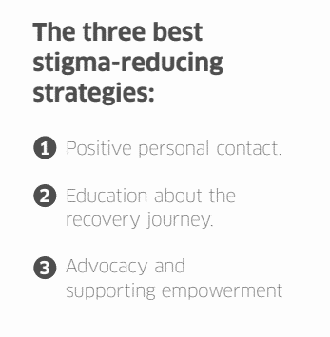
Positive personal contact
Education about the
recovery journey
Advocacy and
supporting empowerment
Notes:
TRAINER
The Mental Health Commission of Canada states the three best stigma-reducing strategies are “positive personal contact, education about the recovery journey, and advocacy and supporting empowerment.” These are all embodied in the work of Peer Support.

Slide 20
Scenario
Module 3 – History of Peer Support
You are in a staff meeting and you feel that the comments the staff are making about the service recipients are insulting. As a member of the team:
What do you THINK or FEEL about this?
What do you SAY or DO about this?
Notes:
TRAINER
This scenario can be worked through as a group. It should take approx. 10-15 minutes, depending on how much people participate. If the group is larger (and you have enough time), they can be broken up into two or three smaller break-out rooms.
“What you think/feel might not be the same as what you do, as it depends on your comfort level and your position in the organization.”
Pros and cons of the scenario are listed on the next slide.

Slide 21
What are the PROS and CONS of each option?
Module 3 – History of Peer Support
Refuse to participate and leave the meeting.
Openly express your disapproval of the comments and use this as a teachable moment.
Report them to their supervisor.
Keep quiet so you don’t risk losing your job.
Notes:
TRAINER
This slide builds on the previous one. We don’t want to suggest that is one right answer, as this often depends upon context, such as the individual’s comfort level and position within the organization.

Slide 22
Homework
Module 3 – History of Peer Support
For Next Time:
Read Moira’s story about Stigma and answer the following questions:
Do you recognize any examples of self-stigma within yourself?
If not, are there any examples of self-stigma you USED to experience or have seen in a peer?
Describe the experience and suggest one thing that might have helped to reduce this self-stigma.
To be submitted before the next session.
Notes:
COORDINATOR
This last slide contains the homework for the following session. Remind the class that the focus is on quality not quantity. They might not have a long answer to every question and that is okay! The main purpose of these questions is to spark inspiration and encourage the participants to reflect on their own experiences with stigma.

Slide 23
Thank You
Notes:
TRAINER
Thank everyone for their time and ask if anyone has any final comments or questions that they want to bring forward.

